Slide 1
GBC Events Management System
Viacheslav Nepomniashchyi Aregawi Gebremicaeal Katiuscia Novaes de Sa Hussein Khalifa

Slide 2
Project Description
GBC Events Management is a new web application designed to manage the George Brown College community’s events in one place, it will host college events and educational content with an integrated commenting. Developed in PHP the web system is expected to be user friendly for event participants as well as event organizers. The software will be easily maintainable and upgradable according to the number of users.

Slide 3
In-Scope
• Creating a web system that facilitates information control and meets the requirements of the users involved;
• Maintaining control for creation and management of the training activities conducted by employees;
• Providing for a system with a clear, scalable, intuitive code of easy maintenance;
• Implementation of the methodologies established through the system analysis, modelling and development;

Slide 4
Out-of-Scope
• Persons without valid GBC student ID;
• Non-evaluative nature;
• Any work not specifically defined in this document;

Slide 5
MOCK UP

Slide 6
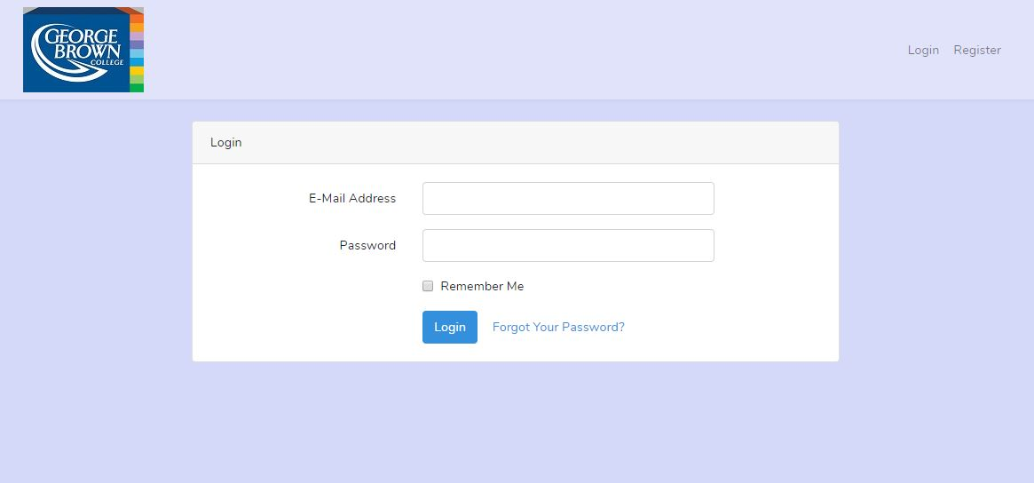
Login

Slide 7
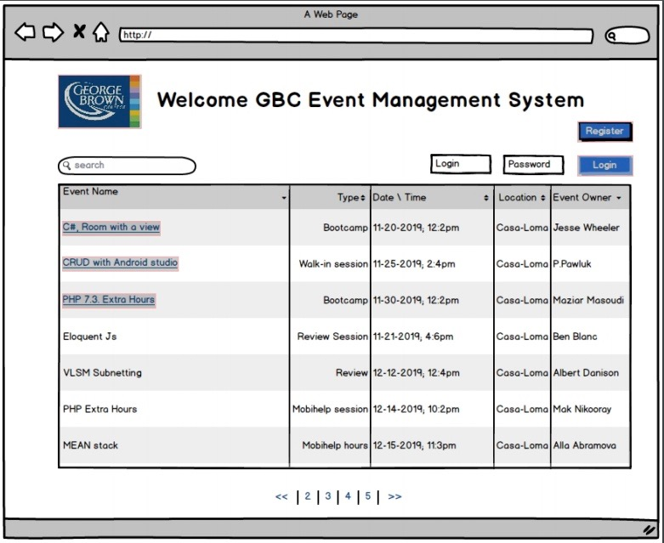
Welcome Page

Slide 8
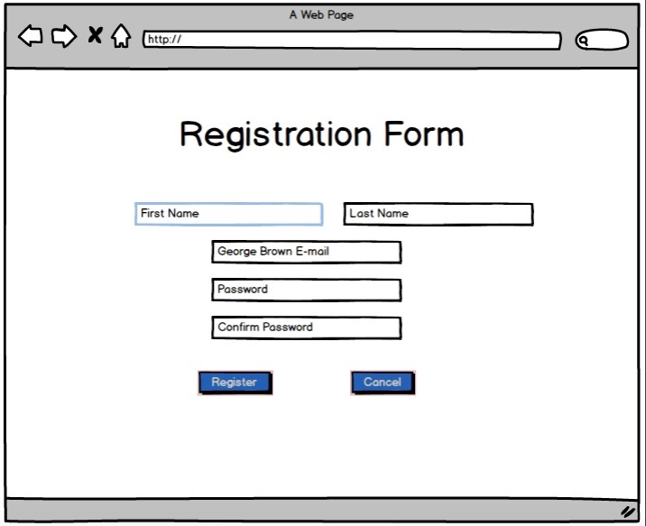
Registration Form

Slide 9
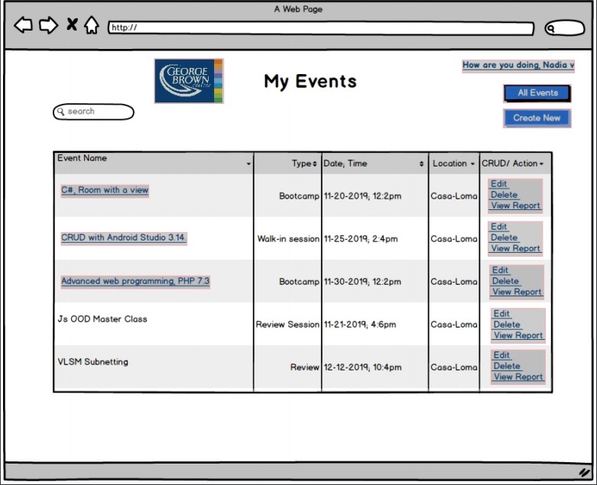
Events Page

Slide 10
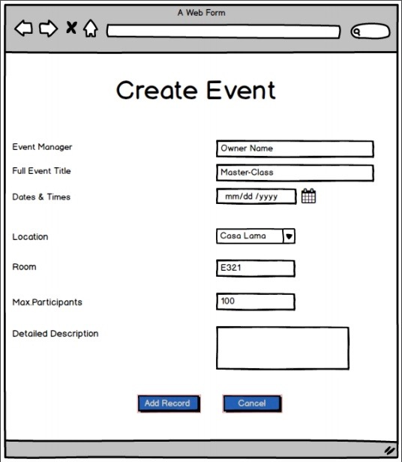
Create Event

Slide 11
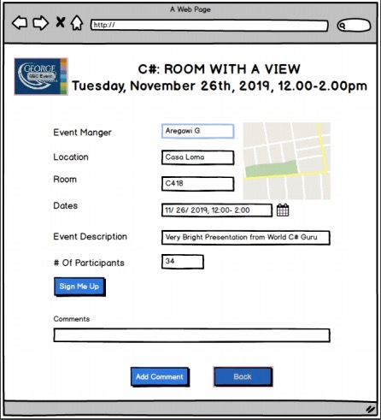
Event Sign up

Slide 12
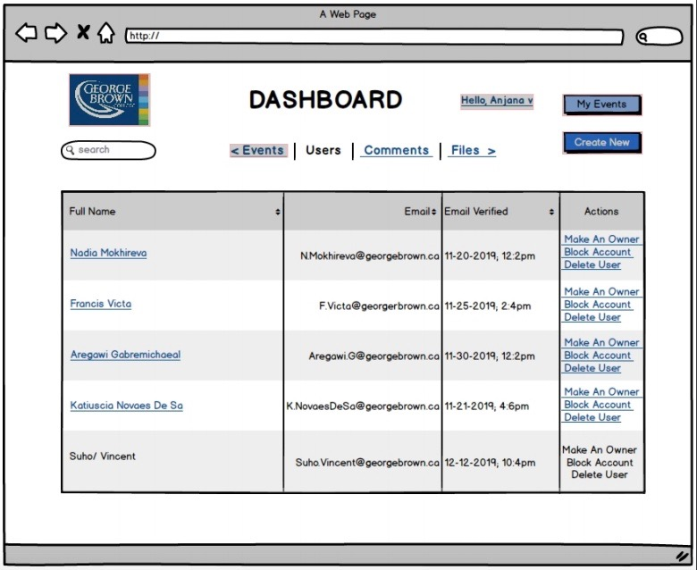
Dashboard

Slide 13
Technology Requirements
Database: InnoDB, SQL Database;
Programming languages: PHP 7.3, Java Script;
Framework: Laravel 5.7;

Slide 14
Technology Requirements
PHP >= 7.2.0
BCMath PHP Extension
Type PHP Extension
JSON PHP Extension
Mbstring PHP Extension
OpenSSL PHP Extension
PDO PHP Extension
Tokenizer PHP Extension
XML PHP Extension

Slide 15
Technology Justification
InnoDB database would allow Admin user to manage related database records easily.
Combination of the Laravel backend and SQL database can be installed with ease and perfectly works on the product owner’s server.

Slide 16
Conclusion
Next steps:
Create and setup the myPhP database.
Learn and implement bootstrap .
Upload website to Server.
Get Registration and Events Page working .
Complete website with features.
Bug and testing.

Slide 17
GBC Events Management System
Thank you,
and have a great day!

